Slide 1

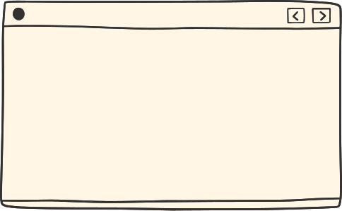


Quiz Management System
BY: Shreyash Shukla
Sachin Sharma
Ponting Raj

Slide 2




Introduction
The Quiz Management System allows users to take quizzes and admins to manage quizzes, questions, and results.
Built using a full-stack architecture:
Frontend: React.js (User Interface)
Database: MySQL (Data Storage)

Slide 3
System Architecture
Frontend (React.js):
User login/registration, quiz display, question navigation.
Fetches data.
Backend:
Handles business logic and routing.
Interacts with MySQL.
Database (MySQL):
Stores users, quizzes, questions, and attempt results.

Slide 4
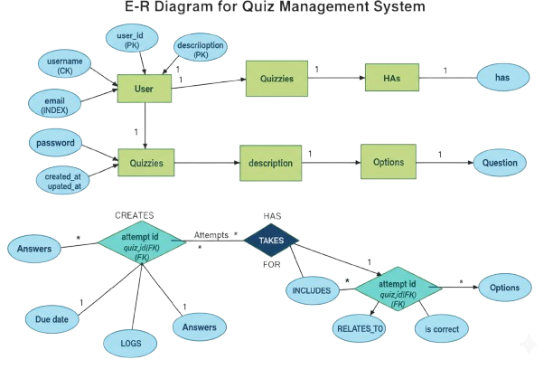
ER Diagram

Slide 5
Database Design (MySQL)
Database Name: quiz_app_db
Entities & Tables:
Users Table
user_id (PK), username, email, fullName, role, password, refreshToken, created_at, updated_at
Keys:
Primary Key: user_id
Candidate Keys: email, username
Quizzes Table
quiz_id (PK), title, description, creator_id, created_at
Questions Table
question_id (PK), quiz_id, question_text, created_at
Options Table
option_id (PK), question_id, option_text, is_correct
Attempts Table
attempt_id (PK), user_id, quiz_id, score, started_at, completed_at
Answers Table
answer_id (PK), attempt_id, question_id, selected_option_id

Slide 6
SQL Operations
Operation | Example SQL Command
Create | INSERT INTO quizzes (title) VALUES ('Math Quiz');
Read | SELECT * FROM questions WHERE quiz_id=2;
Update | UPDATE users SET role='admin' WHERE user_id=1;
Delete | DELETE FROM attempts WHERE attempt_id=5;
Join | SELECT u.name, q.title, a.score FROM attempts a JOIN users u ON a.user_id=u.user_id JOIN quizzes q ON a.quiz_id=q.quiz_id;

Slide 7
Conclusion & Future Scope
Conclusion:
Developed a secure, scalable Quiz Management System using MySQL backend and React frontend.
Demonstrates authentication, and relational data management.
Future Enhancements:
Add leaderboards and timer-based quizzes.
Include email notifications and admin analytics.
Deploy on cloud (Render / AWS / Railway).

